Slide 1
BSc. Statistical Data Science · Academic Writing
Scholars in
Statistical Data Science
Their Published Works & Contributions to Society
10
Distinguished
Scholars
University of Mines and Technology, Tarkwa · June 2026

Slide 2
About Our Programme
📊
🔬
💡
Statistics
Data Science
Statistical Data Science
The science of collecting, organising, analysing, interpreting and presenting data (Dodge, 2006). Formally named in the 17th century.
Largely considered to have begun with Cleveland's 2001 action plan. Uses scientific methods & algorithms to extract insights from structured and unstructured data.
Practice of using rigorous statistical methods to extract meaning from data, powered by modern computing tools.
UMaT is among only 2 institutions in Ghana — and fewer than 15 globally — offering this programme.

Slide 3
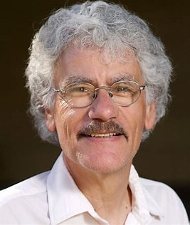
📷
Insert Photo
Prof. Jerome H. Friedman
Statistician | Machine Learning Pioneer | Stanford University
Born 1939, California. PhD in High Energy Particle Physics, UC Berkeley (1967). Joined Stanford in 1972 and appointed Professor of Statistics in 1982. Fellow of the ASA (1984), member of the National Academy of Sciences (2010), and recipient of the ACM SIGKDD Innovation Award (2002). Over 263,000 Google Scholar citations — one of the founding figures of modern statistical machine learning.
🇺🇸 American
CART
Gradient Boosting
MARS
Regularisation

Slide 4
Prof. Jerome H. Friedman — Contributions & Publications
Key Contributions
Selected Publications
Classification & Regression Trees (CART)
Co-developed with Breiman (1984) — foundation of virtually all modern decision tree methods. Gradient Boosting Machines (GBM)
Landmark sequential learning technique (1999/2001) underpinning XGBoost & LightGBM — used in fraud detection, medical diagnosis, and financial risk. Multivariate Adaptive Regression Splines (MARS)
Flexible nonparametric regression for high-dimensional data (1991). Democratised advanced predictive modelling worldwide.
1. Breiman, Friedman et al. (1984) Classification and Regression Trees. Wadsworth. 2. Friedman & Stuetzle (1981) 'Projection Pursuit Regression', JASA 76(376). 3. Friedman (1991) 'MARS', Annals of Statistics 19(1), pp. 1–67. 4. Friedman (2001) 'Greedy Function Approximation: A GBM', Annals of Statistics 29(5). 5. Hastie, Tibshirani & Friedman (2009) The Elements of Statistical Learning. Springer. 6. Friedman, Hastie & Tibshirani (2010) 'Regularization Paths for GLMs via Coordinate Descent', J. Stat. Software 33(1).

Slide 5
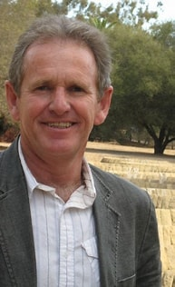
Prof. Trevor Hastie
📷
Insert Photo
Statistician | Founding Father of Statistical Learning | Stanford
Born 1953, South Africa. PhD in Statistics, Stanford (1984). Professor at Stanford ever since. Co-developed Generalised Additive Models (GAMs) with Tibshirani, popularised Lasso regression (1996), and co-authored two landmark textbooks freely available online. Widely described as a founding father of statistical learning for bridging classical statistics with modern machine learning.
🇿🇦 South African-American
GAMs
Lasso
Stat. Learning
Biostatistics

Slide 6
Prof. Trevor Hastie — Contributions & Publications
Key Contributions
Selected Publications
Generalised Additive Models (GAMs)
Allowed data to 'draw curves' instead of straight lines — enabling doctors to model disease risk with age and banks to predict loan defaults while maintaining interpretability. Lasso Regression
Co-popularised in 1996; automatically weeds out useless variables. Built into scikit-learn and glmnet — used by data scientists daily. Statistical Learning Theory
Gave the field rigorous foundations via bias-variance tradeoff and overfitting theory — trusted in healthcare and finance where mistakes cost lives.
1. Hastie & Tibshirani — Generalized Additive Models. Chapman and Hall. 2. Hastie, Tibshirani & Friedman (2009) The Elements of Statistical Learning. Springer. [Free online] 3. James, Witten, Hastie & Tibshirani — An Introduction to Statistical Learning. Springer. [Free online] 📚 Both ESL and ISLR are freely available online — Stanford gives away the 'bible of data science' to anyone with internet access.

Slide 7
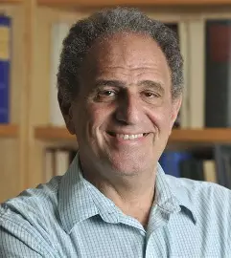
📷
Insert Photo
Prof. Robert Tibshirani
Statistician | Pioneer of the Lasso | Stanford University
Born July 10, 1956, Canada. BSc from Waterloo (1979), MSc Toronto (1980), PhD Stanford (1984) under Bradley Efron. Professor at University of Toronto (1985–1998), then Stanford. Fellow of the ASA and IMS, elected to the Royal Society in 2019. Over 615,000 Google Scholar citations — enormous influence on statistics and data science.
🇨🇦 Canadian-American
Lasso (L1)
Biostatistics
Genomics
Data Mining

Slide 8
Prof. Robert Tibshirani — Contributions & Publications
Key Contributions
Selected Publications
The Lasso
Proposed L1 penalisation in regression (1996) — automatic variable selection that revolutionised analysis of high-dimensional data (e.g. thousands of genes, few patients). Significance Analysis of Microarrays (SAM)
Statistical technique to interpret data from DNA experiments, now standard in genomics research. Biomedical Data Science
Develops software packages for genomics and proteomics; current research on post-selection inference and large-scale data analysis. COPSS Presidents' Award (1996).
1. Hastie & Tibshirani — Generalized Additive Models. Chapman and Hall. 2. Efron & Tibshirani — An Introduction to the Bootstrap. Chapman and Hall. 3. Hastie, Tibshirani & Friedman — Elements of Statistical Learning. Springer. 4. Tibshirani et al. — Significance Analysis of Microarrays (SAM). 🏆 COPSS Presidents' Award 1996 · Fellow ASA & IMS · Royal Society 2019

Slide 9
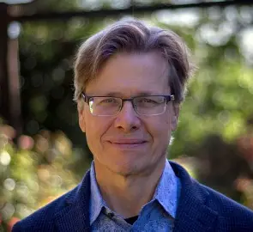
📷
Insert Photo
Dr. David Donoho
Mathematician | Statistician | Data Science Pioneer | Stanford
Undergraduate at Princeton; PhD from Harvard. Holds the Anne T. & Robert M. Bass Professorship at Stanford. MacArthur Fellowship (1992), COPSS Presidents' Award, Norbert Wiener Prize, Shaw Prize in Mathematical Sciences. Member of the NAS and AAAS. One of the most-cited mathematicians in the world, his work spans signal processing, high-dimensional statistics, and the foundations of data science.
🇺🇸 American
Wavelets
Compressed Sensing
High-Dim Stats
Reproducibility

Slide 10
Dr. David Donoho — Contributions & Publications
Key Contributions
Selected Publications
Wavelets & Image Compression
Leading figure in wavelet theory; work directly influenced JPEG2000 — used in digital photography, medical imaging (CT/X-ray), and satellite imagery. Compressed Sensing
With Candès & Tao (2006): accurate signal reconstruction from far fewer measurements than classical theory requires. MRI scans now completed in a fraction of previous time. 50 Years of Data Science (2017)
Influential essay on rigorous, transparent data science practice. Also a key voice on the reproducibility crisis in science.
1. Donoho & Johnstone (1994) 'Ideal Spatial Adaptation by Wavelet Shrinkage', Biometrika 81(3). 2. Donoho (1995) 'De-noising by Soft-Thresholding', IEEE Trans. Info. Theory 41(3). 3. Candès, Romberg & Tao (2006) 'Robust Uncertainty Principles', IEEE Trans. Info. Theory 52(2). 4. Donoho (2006) 'Compressed Sensing', IEEE Trans. Info. Theory 52(4). 5. Donoho (2017) '50 Years of Data Science', J. Computational & Graphical Statistics 26(4).

Slide 11
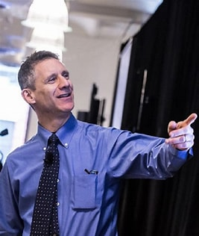
Prof. Andrew Gelman
📷
Insert Photo
Statistician | Bayesian Methods Pioneer | Columbia University
Born February 11, 1965, Philadelphia. BS Mathematics & Physics, MIT (1986); PhD Statistics, Harvard (1990) under Donald Rubin. Higgins Professor of Statistics & Professor of Political Science, Columbia University. COPSS Presidents' Award (2003). Elected Fellow, ASA, IMS, and American Academy of Arts & Sciences (2020). Co-developer of Stan — a widely used probabilistic programming language.
🇺🇸 American
Bayesian Stats
Multilevel Models
Stan
Political Science

Slide 12
Prof. Andrew Gelman — Contributions & Publications
Key Contributions
Selected Publications
Bayesian Data Analysis & Stan
Co-developed Stan (open-source), used in academia, government, pharma, and tech worldwide. His Bayesian Data Analysis textbook is the graduate standard across disciplines. Multilevel Modelling
Made hierarchical models standard tools in social science, epidemiology, and education research. Statistical Reform & Reproducibility
Coined 'garden of forking paths' to explain inflated research findings. Consistent critic of p-value misuse. Public blog since 2004 widely read by researchers globally.
1. Gelman et al. (1995/3rd ed. 2013) Bayesian Data Analysis. Chapman & Hall/CRC. 2. Gelman & Hill (2006) Data Analysis Using Regression and Multilevel/Hierarchical Models. Cambridge. 3. Gelman et al. (2008) Red State, Blue State, Rich State, Poor State. Princeton UP. 4. Gelman, Hill & Vehtari (2020) Regression and Other Stories. Cambridge. 🏆 COPSS 2003 · ASA Fellow · AAAS 2020 · Mitchell Prize & DeGroot Prize (ISBA 2008)

Slide 13
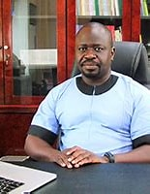
📷
Insert Photo
Prof. Samuel Kobina Annim
Economist | Statistician | Former Government Statistician of Ghana
BA Economics, University of Cape Coast; PhD from University of Manchester; Post-doctoral Fellow, University of Central Lancashire. Professor at UCC, then Government Statistician of Ghana (GSS) 2019–2025. Co-chaired the UN High-Level Group for Statistics for the 2030 Agenda. Approximately 80 peer-reviewed publications; over 3,240 citations.
🇬🇭 Ghanaian
Microfinance
Poverty & Inequality
Data Governance
Health Outcomes

Slide 14
Prof. Samuel Kobina Annim — Contributions & Publications
Key Contributions
Selected Publications
Modernising National Statistics
As Government Statistician, integrated data science, AI-readiness, and experimental methods into Ghana Statistical Service — championing that $1 invested in data yields ~$32 in development value. Microfinance & Poverty Research
Extensive empirical work on MFI efficiency, child deprivation, income inequality, and gender gaps in financial access across Africa and Asia. Academic Infrastructure
Established UCC's Data Repository Centre; institutionalised microfinance research programmes connecting empirical rigour to poverty policy.
1. Imai, Arun & Annim (2010) 'Microfinance & Household Poverty Reduction', World Development 38(12). 2. Annim, Mariwah & Sebu (2012) 'Spatial Inequality & Household Poverty in Ghana', Economic Systems 36(4). 3. Imai, Gaiha, Thapa & Annim (2012) 'Microfinance and Poverty: A Macro Perspective', World Development 40(8). 4. Imai, Annim et al. (2014) 'Women's Empowerment & Prevalence of Stunted Children in Rural India', World Development 62. 5. You & Annim (2014) 'Impact of Microcredit on Child Education', Journal of Development Studies 50(7).

Slide 15
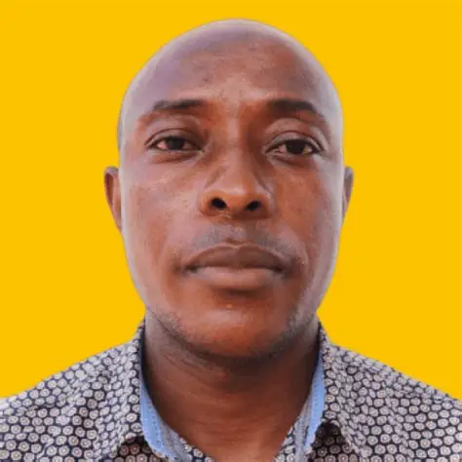
📷
Insert Photo
Prof. Suleman Nasiru
Professor of Statistics | CK Tedam University of Technology & Applied Sciences
BSc Mathematical Science (First Class), UDS (2009); MSc Applied Statistics, UDS (2013); PhD Mathematics (Statistics), Pan African University, Kenya (2018). Head of Department, Statistics & Actuarial Science, CKT-UTAS, Navrongo. H-index: 19 (all time), 16 (last 5 years). Over 105 peer-reviewed publications and 1,167+ citations.
🇬🇭 Ghanaian
Statistical Distributions
Time Series
Forecasting
Machine Learning

Slide 16
Prof. Suleman Nasiru — Contributions & Publications
Key Contributions
Selected Publications
Statistical Distributions Research
Prolific developer of novel statistical distribution families used in lifetime data analysis and reliability engineering. Recent work: Log-Cosine-Power Generated Family of Distributions (2025). Time Series & Forecasting
Applied forecasting methodologies for real-world Ghanaian and African datasets in health, agriculture, and environmental domains. Machine Learning & Disease Classification
Developing AI-powered disease classification models. Member of Statistics Without Borders and Ghana Statistical Association.
Research Metrics: 105+ publications · 1,167+ citations H-index: 19 (total) · 16 (last 5 yrs) i10-index: 39 (total) · 32 (last 5 yrs) Notable Works: • Nasiru et al. (2025) 'Log-Cosine-Power Generated Family of Distributions' • Ocloo, Brew, Nasiru & Odoi (2022) 'Harmonic Mixture Frechet Distribution', Int. J. Mathematics & Mathematical Sciences. Published in journals on statistical theory, machine learning, and applied sciences.

Slide 17
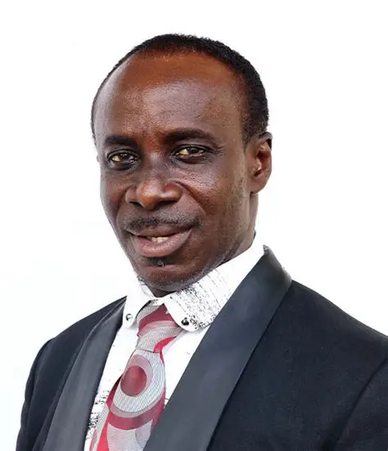
📷
Insert Photo
Assoc. Prof. Lewis Brew
Mathematician | Statistician | University of Mines and Technology
BEd Applied Mathematics, UEW; MSc Pure Mathematics, KNUST; PhD Pure Mathematics, UMaT. Department of Mathematical Sciences, UMaT, Tarkwa. Served as Dean of Faculty of Computing & Mathematical Sciences and Dean of Students. Research bridges pure mathematics and applied statistics with focus on Ghanaian social, economic, and health data.
🇬🇭 Ghanaian
Algebraic Topology
Time Series (ARIMA)
Applied Stats
Maths Education

Slide 18
Assoc. Prof. Lewis Brew — Contributions & Publications
Key Contributions
Selected Publications
Time Series & Data-Driven Modelling
Applied Box-Jenkins (ARIMA/ARMA) methodology and regression analysis to Ghanaian transport safety, public health, taxation, and agricultural productivity. Rigorous Analytic Practice
Embedded AIC/BIC model-selection criteria, Augmented Dickey-Fuller tests, and Ljung-Box diagnostics into applied research in Ghana's academic context. Mathematics Education
Investigated classroom factors influencing students' mathematical performance at senior high school level.
1. Brew (2011) 'Mathematical activities & classroom factors', British J. Arts & Social Sciences 2(1). 2. Brew & Wiah (2012) 'Efficiency in VAT collection — Tarkwa-Nsuaem using time series', British J. Arts & Social Sciences 6(2). 3. Buabeng, Brew, Odoi et al. (2020) 'Effect of climate change on maize production in Ghana', UMaT Biennial Conf. 4. Twenefour, Ayitey, Kangah & Brew (2021) 'Time series analysis of road traffic accidents in Ghana', Asian J. Prob. & Statistics 11(2). 5. Ocloo, Brew, Nasiru & Odoi (2022) 'Harmonic Mixture Frechet Distribution', Hindawi.

Slide 19
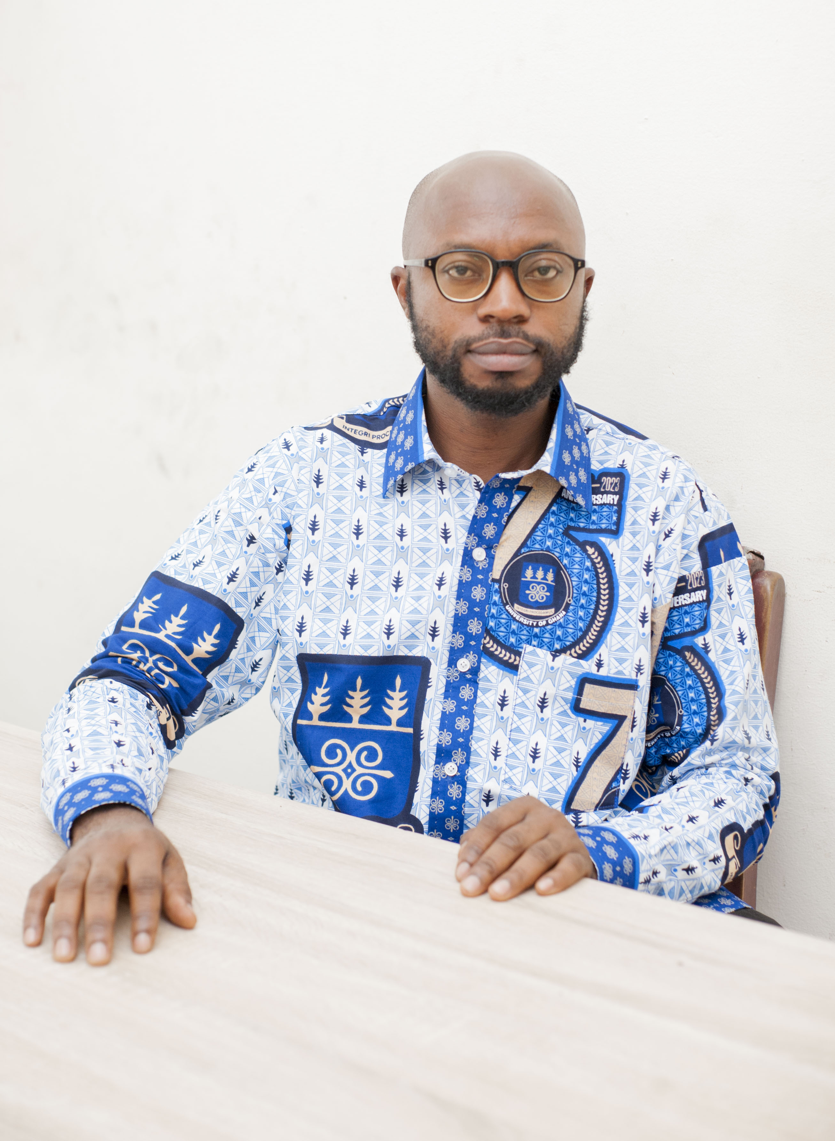
📷
Insert Photo
Dr. Eric Nyarko
Senior Lecturer in Statistics | University of Ghana
BSc Statistics, University for Development Studies; MPhil Statistics, University of Ghana; PhD Statistics, University of Magdeburg, Germany. Senior Lecturer, Department of Statistics & Actuarial Science, University of Ghana. Applies statistical design, machine learning, and discrete choice methods to public health, infectious diseases, nutrition, and snakebite prevention.
🇬🇭 Ghanaian
Design of Experiments
Machine Learning
Discrete Choice
Public Health

Slide 20
Dr. Eric Nyarko — Contributions & Publications
Key Contributions
Selected Publications
Optimal Experimental Design
Develops optimal designs for paired comparison and conjoint analysis experiments — particularly for 2nd and 3rd order interactions with binary attributes. Public Health & Disease Modelling
Applies statistical & ML methods to antimicrobial resistance, COVID-19 impacts on higher education, snakebite prevention, maternal/child health, and nutrition policy. Class Imbalance in Health Data
Recent work (2025) on oversampling approaches to address class imbalance in health data classification — practical impact on diagnostic accuracy.
1. Nyarko & Schwabe (2019) 'Optimal designs for second-order interactions in paired comparison experiments', J. Statistical Theory & Practice 13(4). 2. Nyarko (2019) 'Optimal paired comparison experiments for second-order interactions', arXiv:1908.06090. 3. Nyarko & Doku-Amponsah (2022) 'Approximate and exact optimal designs for paired comparison', Calcutta Statistical Association Bulletin 74(1). 4. Nyarko, Agyemang & Arku (2023) 'COVID-19 and online teaching: A discrete choice experiment', Model Assisted Statistics & Applications 18(2). 5. Agyemang, Mensah, Nyarko et al. (2025) 'Addressing class imbalance in health data classification', Applied Computational Intelligence & Soft Computing.

Slide 21
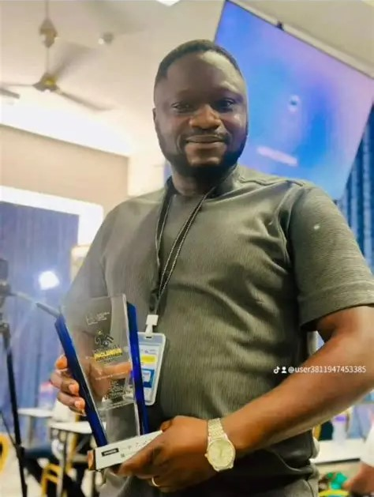
📷
Insert Photo
Dr. Benjamin Odoi
Statistician | Big Data Analyst | University of Mines and Technology
BSc Mathematics; MSc Applied Statistics; MPhil Statistics; PhD Statistics. Certifications in Advanced Data Science, Big Data Analytics, and Mining Engineering. Lecturer, Department of Mathematical Sciences, UMaT, Tarkwa. Over 25 peer-reviewed publications and 100+ citations. Presented at LISA Global Symposium 2025 and ISI-IASC Webinar on data science storytelling.
🇬🇭 Ghanaian
Big Data Analytics
Climate Modelling
Financial Stats
Biostatistics

Slide 22
Dr. Benjamin Odoi — Contributions & Publications
Key Contributions
Selected Publications
Big Data Analytics & Statistical Computing
Focuses on building statistical capacity among African students and researchers, positioning statistical computing as the bridge between statistics and computer science. Climate & Environmental Modelling
Studied effects of climate change on Ghana's agriculture; used PCA and time series to predict nitrous oxide emissions. Energy & Health Applications
Compared ARIMA/SARIMA for petrol and diesel price prediction in Ghana; developed ML frameworks for childbirth-related conditions in maternal health research.
1. Odoi, Abubakari, Nutakor & Li (2022) 'Ghana's Inflation and Unemployment: Phillips Curve via VECM', Int. J. Social Sciences & Economic Environment 7(2). 2. Odoi, Brew & Attafuah (2021) 'Principal Component Regression and Time Series to Predict N₂O Emissions in Ghana', Energy Research Journal 12. 3. Ofosu, Odoi et al. (2023) 'Fault Detection of 3-Phase Induction Motor Using Kohonen Self-Organising Map', Jurnal Nasional Teknik Elektro 12(1). 4. Ocloo, Brew, Nasiru & Odoi (2022) 'Harmonic Mixture Frechet Distribution', Hindawi. 5. Odoi et al. (2024) 'Predicting Petrol and Diesel Prices in Ghana: ARIMA vs SARIMA', Int. J. Innovative Technology & Exploring Engineering.

Slide 23
Thank You
1. Jerome H. Friedman
6. Samuel K. Annim
2. Trevor Hastie
7. Suleman Nasiru
3. Robert Tibshirani
8. Lewis Brew
4. David Donoho
9. Eric Nyarko
5. Andrew Gelman
10. Benjamin Odoi
BSc. Statistical Data Science · University of Mines and Technology · June 2026

